Slide 1
Open Source Software and Digital Sovereignity in Asia: Lessons for Germany
Mamad Farrahi
Notes:
Hi and welcome to my presentation
I’m Mamad Farrahi studying eXtended AI at uni Würzburg
Today I’m gonna present you open-source approaches and digital soverinity in Asian countries and lessons for Germany
Today I’m gonna present you the results of my research about DS and open-source approaches in Asian countries.

Slide 2
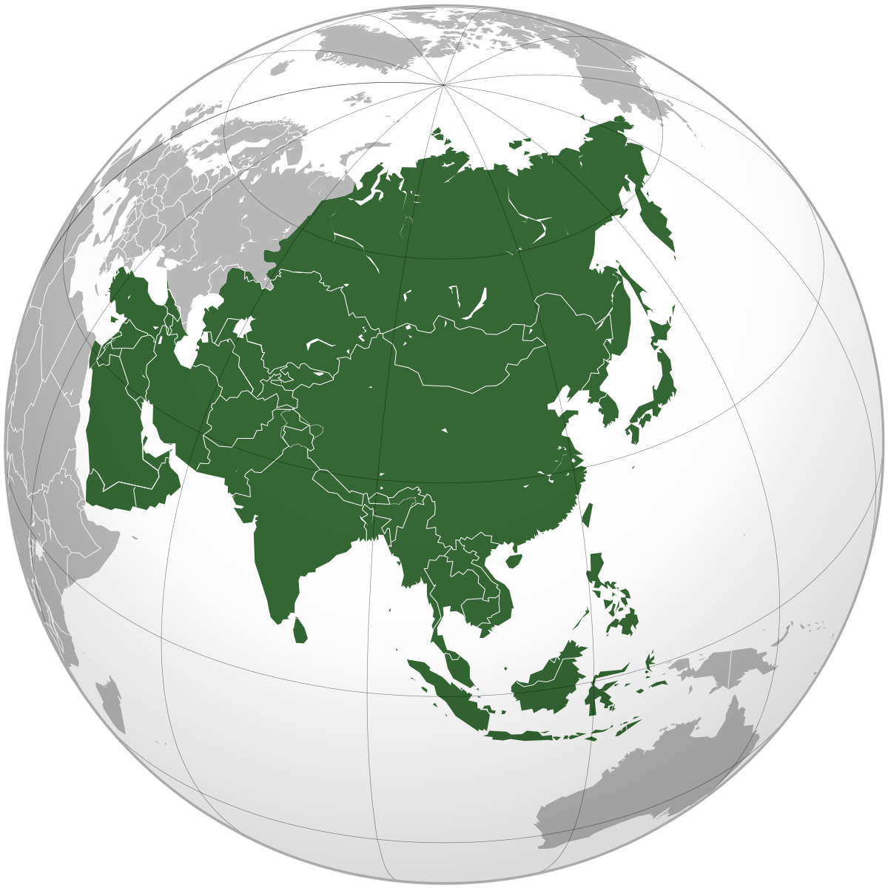
Structure
Open-data and benefits in Governmental Level in Japan 🇯🇵
Open-source in Car Industry and Economical Advantages in China 🇨🇳
Cultural advantages in Iran 🇮🇷
Digital Sovereignty in India 🇮🇳
Notes:
It’s overview of my research
I looked at Japan and how open-data helped the government.
I saw how open-source software helped to transform China's car industry.
I even found how open-source could contribute to a stronger cultural identity and a sense of unity among people.
I also studied India's steps towards digital sovereignty.

Slide 3
Structure
Open-data and benefits in Governmental Level in Japan 🇯🇵
Open-source in Car Industry and Economical Advantages in China 🇨🇳
Cultural advantages in Iran 🇮🇷
Digital Sovereignty in India 🇮🇳
Notes:
For today's presentation, I decided to focus on the lessons that seem most applicable, most beneficial to Germany.
So, we will dive into the open-source approach in China's car industry and India's push for digital sovereignty.

Slide 4
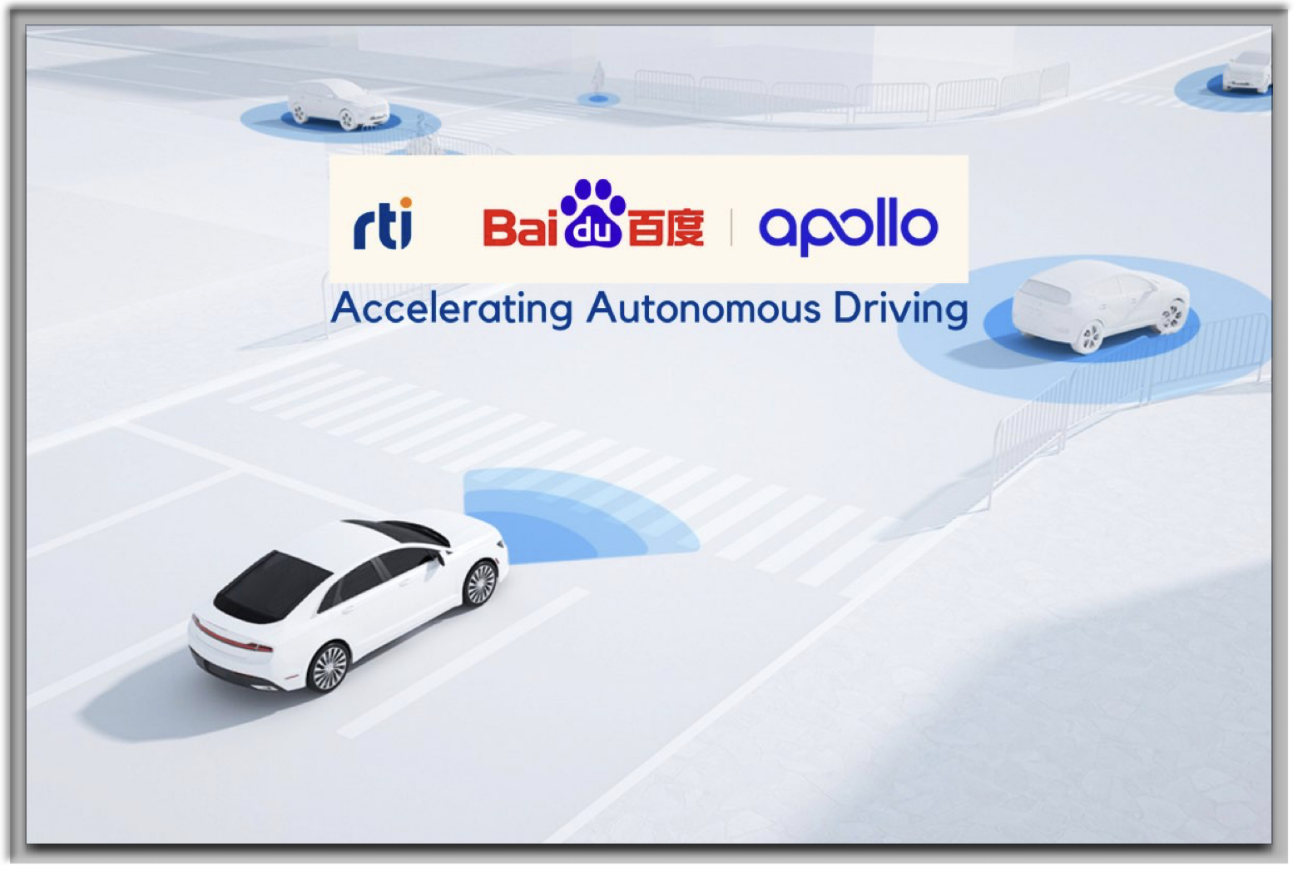
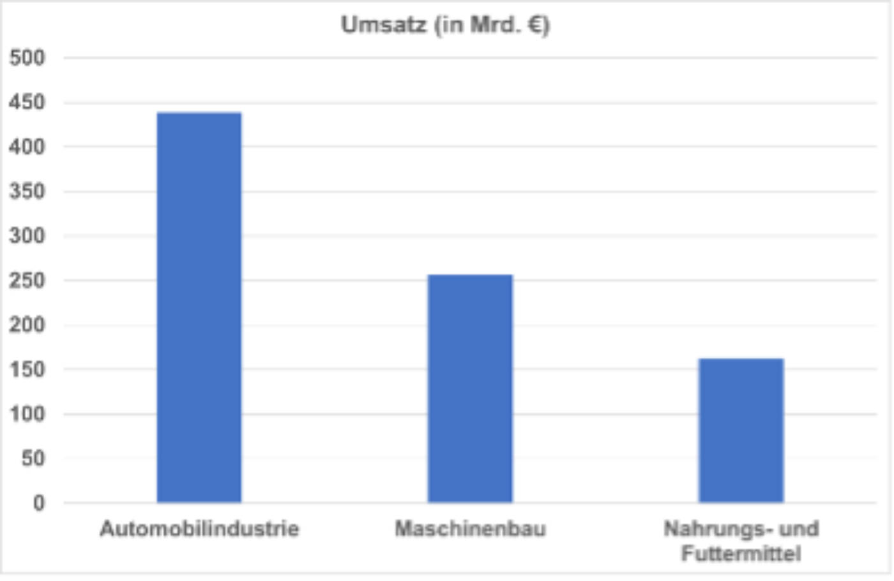
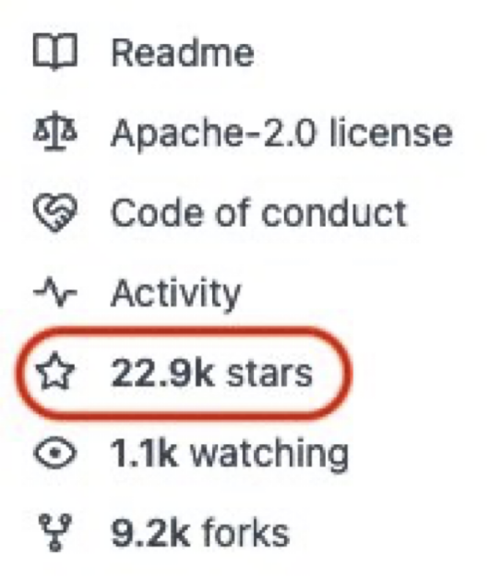
Apollo – A Success Story from China 🇨🇳🇩🇪
from vda.de at 2019
Notes:
Baidu which is a giant IT company in China which is well-known for AI and Internet
They started Apollo project with focus on electric and intelligent cars and only from 2017 till now which is 6 years they could receive 23 thousands of stars on Github and 80K of developers from all over the world
They could reach these successes because of the open-source approach.
What is the lesson for Germany? Well, Car industry is the backbone of German economy.
It has a high contribution to the prosperity and employment
And the challenge is that due to the upcoming change after 2035 selling petrol cars will be stopped
What we need at this point is a fast adaptation and take advance steps towards production of electric cars
I think for Germany using the same approach like Apollo is so much helpful
And it helps Germany to remain the top player in car production all over the world

Slide 5
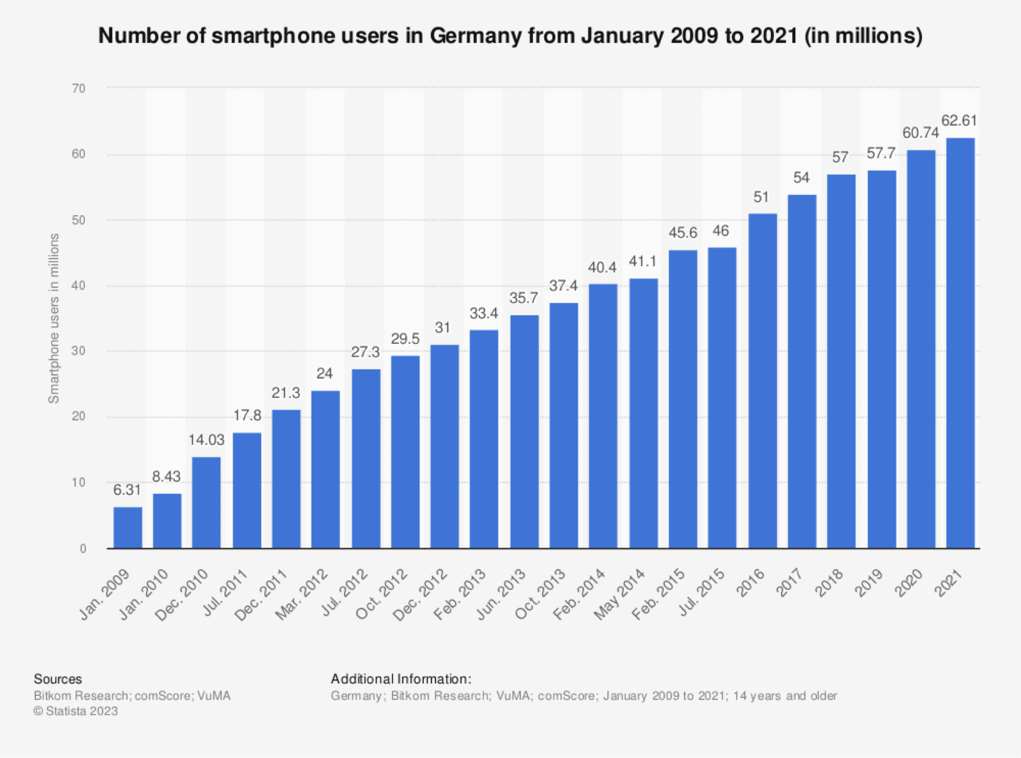
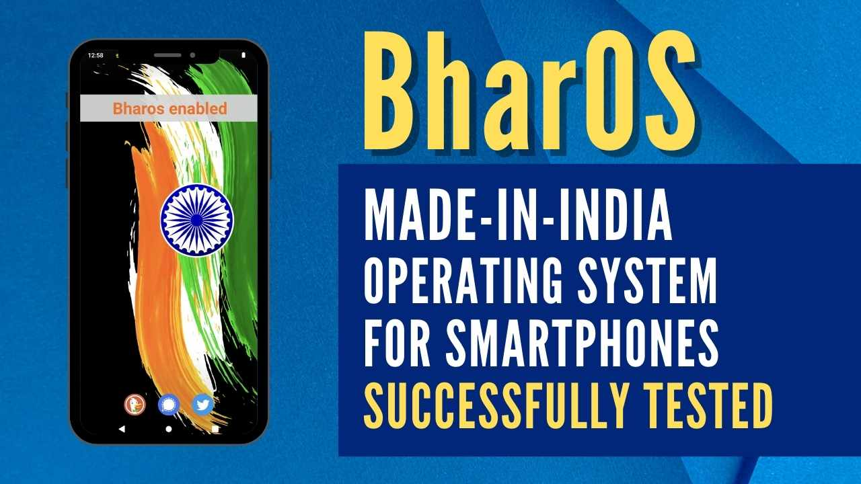


Digital Sovereignty and India 🇮🇳🇩🇪
Notes:
And now let’s shift our attention to DS and India
As all of know, we’re surrounded nowadays with digital products and that’s why DS concept is getting more attention. It means taking control of digital data.
India has been done serious strides towards DS by developing 2 services.
Koo application which is an alternative for Twitter and right now is being used on over 100 countries
Also they’ve been developed an OS which is called BharOS which is a potential alternative for Android devices
As people in Germany do care about Datenschütz, taking the same actions towards DS will be supported and appreciated also by the citizens. Making the local solutions is the only way towards DS

Slide 6


Finishing!
Notes:
At the end I wanna finish my presentation by a quote from Torvalds
open source isn't just about sharing code. ‘It’s is about sharing ideas, trust, and working together.’
As Linus Torvalds, master mind and engineer behind Linux kernel

Slide 7
Thanks for your attention!!!
Collaboration or Questions?
mamad.frhi@gmail.com

